Slide 1
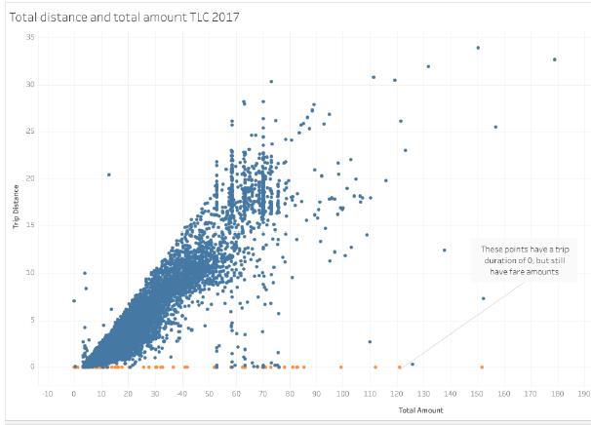
New York City TLC Project Preliminary Data Summary
Executive summary report
Commission Prepared by Automatidata
The NYC Taxi & Limousine Commission has contracted with Automatidata to build a regression model that predicts taxi cab fares. In this part of the project, the Automatidata data team performed a exploratory data analysis (‘EDA’) and visualizations of the data supplied by the NYC Taxi and Limousine Commission in order to inform the team of data conclusions, and ensure the information provided is suitable for generating clear and meaningful insights.
EDA on the dataset to find any unusual values and initial conclusions.
Considered which variables are most useful to build predictive models (in this case: total_amount and trip_distance, which work together to depict a taxi cab ride).
Examined which components of the provided data will provide relevant insights.
Built visualizations on trip distance, day/month revenue, rides by count.
There are no missing values in the data. However, fares were paid for trip with duration 0 miles.
Perform data cleaning on outliers that likely impact a future model.
Decision on identified outliers
Create and run a regression model.
The majority of trips are in the 1-3 miles range. Most total amounts paid for fares fall in the $5-$20 range. Tips are in the $0-$3 range.
Thursday had the highest gross revenue of all days, and Sunday and Monday had the least
Monthly revenue generally follows the pattern of monthly rides, with noticeable dips in the summer months of July, August, and September, and also one in February.

